Slide 1

PREDICTING CREDIT LOAN RISK MODEL
Muhammad Ananda Taj Bara
Virtual Internship Program at ID/X Partners

Slide 2
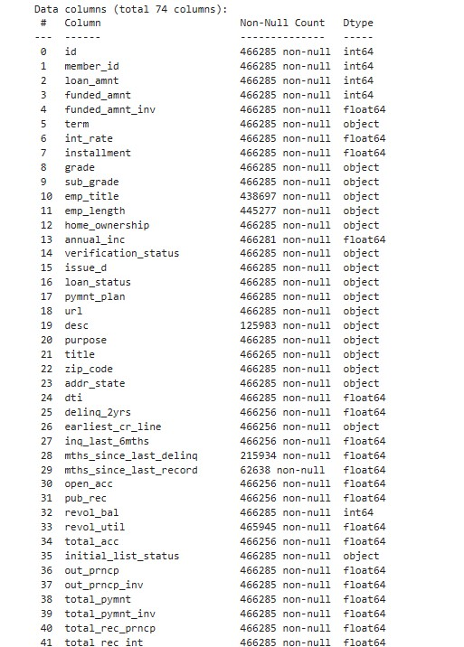
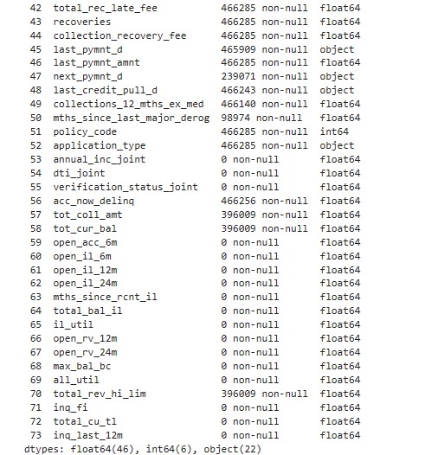
DATASET OVERVIEW
Data Shape : 466.256 entries with 74 columns
Source Code

Slide 3
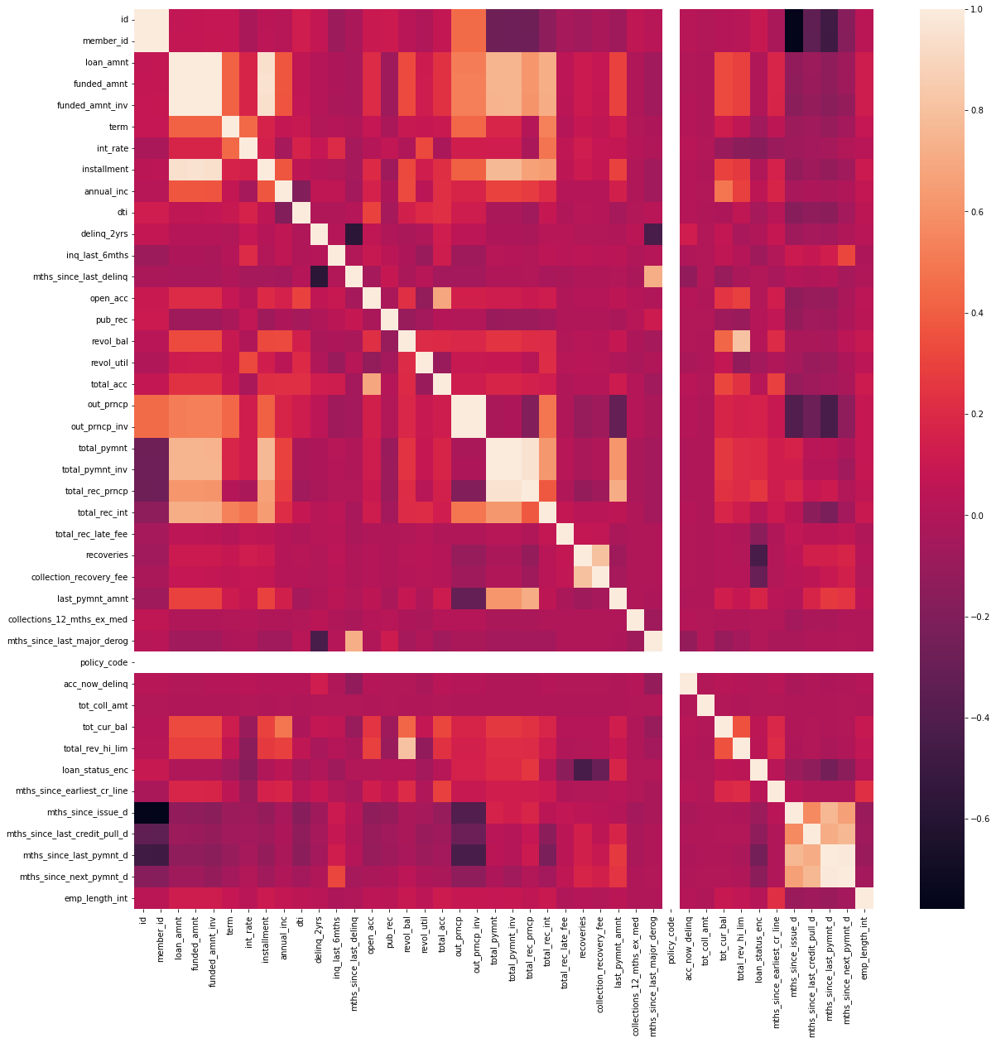
EDA (Exploratory Data Analyst)
The type of exploring data is delinquencies and loan amount by borrowers grade.
Source Code

Slide 4
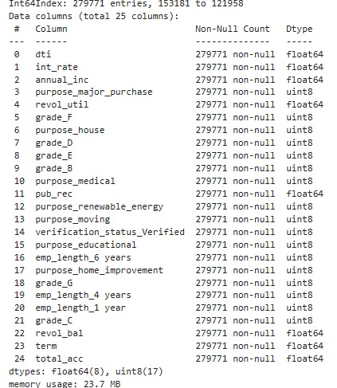
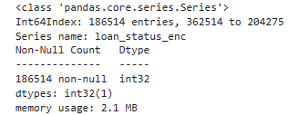
MODEL & FEATURE SELECTING
Model evaluating > cross_val_score, accuracy, f1, precision and recall scores
Feature selecting > DecisionTreeClassifier
Model selected: Logistic Regression
Output: ROC, AUC, and Kolmogorov-Smirnov (KS) scores
Source Code

Slide 5

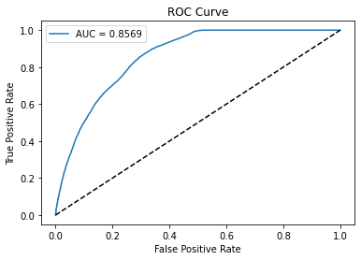
DATA RESULT
The results of the analysis will be used to provide recommendations to the relevant business regarding which factors have the greatest impact on credit risk and how to manage that risk.
Source Code

Slide 6
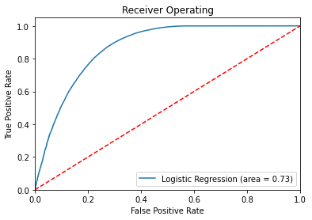
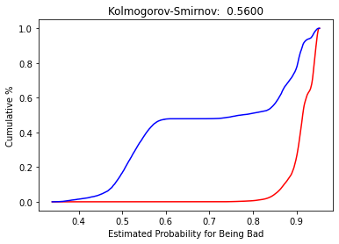
EVALUASION
KS is one regularly employed evaluation metric for credit risk models (Kolmogorov-Smirnov). This metric assesses how effectively the model can distinguish between credits that will succeed and those that will fail (default). The cumulative distribution curve produced by the model for various credit classes serves as the foundation for KS.
Source Code

Slide 7
CONCLUSION
There are no instances of overfitting, according to the lack of a significant variation in the AUC score between the train and test data.
KS values of 0.57 demonstrate good distributional fit.
When the classifier can discriminate between Positive and Negative class points, the AUC is 0.86.
To improve the classifier, more model training with better features and better data exploration are required.
Source Code

Slide 8
Please reach me via: muhammadbara271@gmail.com https://www.linkedin.com/in/muhammad-ananda-taj-bara-41b812179/

